Slide 1
Data structures
Lecturer: Nadia Binte Asif

Slide 2
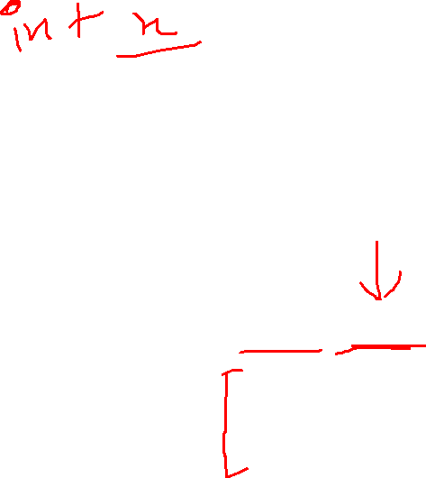
INtro
In C programming, a struct (or structure) is a collection of variables (can be of different types) under a single name.
Struct keyword
struct structureName {
dataType member1;
dataType member2;
...
};
struct Person {
char name[50];
int citNo;
float salary;
};

Slide 3
Creating Variables
When a struct type is declared, no storage or memory is allocated.
To allocate memory → we need to create variables.
struct Person {
char name[50];
int citNo;
float salary;
};
int main() {
struct Person person1, person2, p[20];
return 0;
}
struct Person {
char name[50];
int citNo;
float salary;
} person1, person2, p[20];

Slide 4
Access members
struct Person {
char name[50];
int citNo;
float salary;
} person1, person2, p[20];
‘ . ‘ : Member operator
‘ →’ : Structure pointer operator
Suppose you want to access the salary of person2
person2.salary

Slide 5
#include <stdio.h>
#include <string.h>
// create struct with person1 variable
struct Person {
char name[50];
int citNo;
float salary;
} person1;
int main() {
strcpy(person1.name, "George Orwell");
person1.citNo = 1984;
person1. salary = 2500;
printf("Name: %s\n", person1.name);
printf("Citizenship No.: %d\n", person1.citNo);
printf("Salary: %.2f", person1.salary);
return 0;
}
Output
Name: George Orwell
Citizenship No.: 1984
Salary: 2500.00

Slide 6
TypeDef
Aliasing: Aliasing refers to the situation where the same memory location can be accessed using different names.
We use the typedef keyword to create an alias name for data types.
struct Distance{
int feet;
float inch;
};
int main() {
struct Distance d1, d2;
}
typedef struct Distance {
int feet;
float inch;
} distances;
int main() {
distances d1, d2;
}

Slide 7
Access members using Pointer
#include <stdio.h>
struct person {
int age;
float weight;
};
int main() {
struct person *personPtr, person1;
personPtr = &person1;
printf("Enter age: ");
scanf("%d", &personPtr->age);
printf("Enter weight: ");
scanf("%f", &personPtr->weight)
printf("Displaying:\n");
printf("Age: %d\n", personPtr->age);
printf("weight: %f", personPtr->weight);
return 0;
}
personPtr->age is equivalent to (*personPtr).age
personPtr->weight is equivalent to (*personPtr).weight

Slide 8
Nested Structure
struct parent {
int member1;
struct member_str member2 {
int member_str1;
char member_str2;
...
}
...
}
HOW TO ACCESS?
str_parent.str_child.member;

Slide 9
LIMITATIONS
Higher Memory Consumption: It is due to structure padding.
No Data Hiding: C Structures do not permit data hiding. Structure members can be accessed by any function, anywhere in the scope of the structure.
Functions inside Structure: C structures do not permit functions inside the structure so we cannot provide the associated functions.
Static Members: C Structure cannot have static members inside its body.

